Slide 1
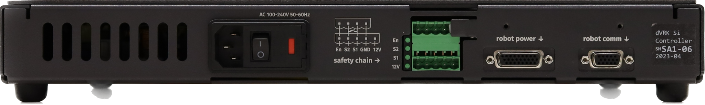
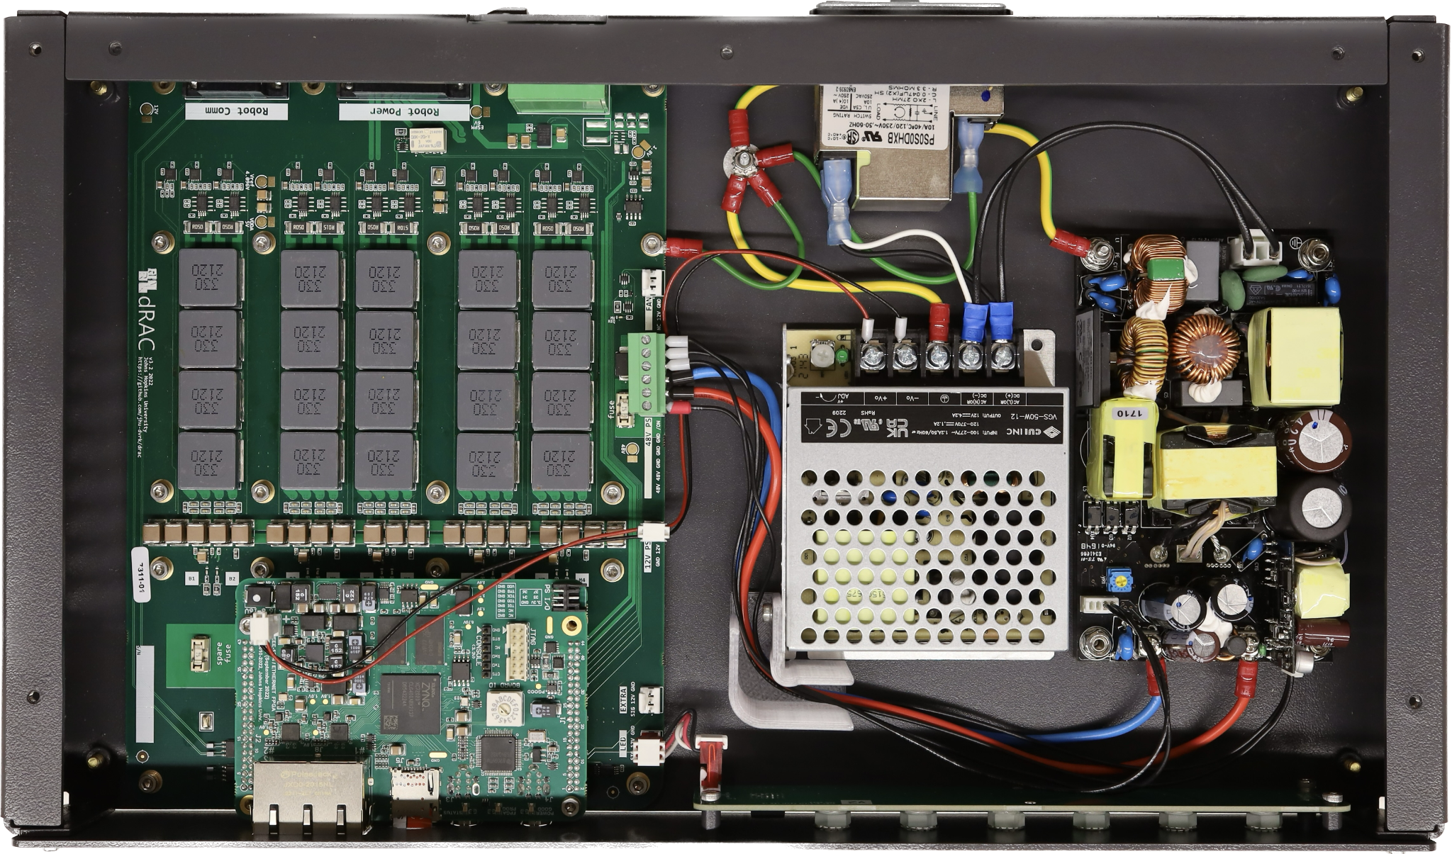
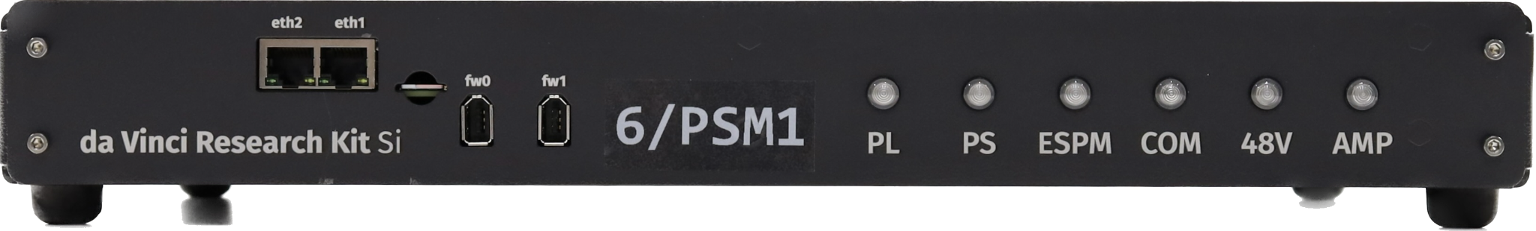
Robot
Safety chain
dRAC
48V
12V
FPGA
LED
Ethernet Firewire

